Slide 1
Tomosynthesis Project
Overview

Slide 2
Outline
Data
Problem Intro
Workflow
Preprocessing
Mass Initial Detection
Mass Segmentation
Mass Classification
Calcification Detection

Slide 3
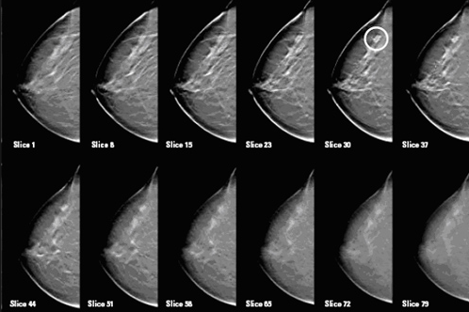
Data
Data
Large Volume (300 ~ 500 MB): 16 bits compressed video
3D Reconstruction: including 50~70 slices typically
High Resolution: (1000~1500)* (2000~2500) pixels

Slide 4
Outline
Data
Problem Intro
Workflow
Preprocessing
Mass Initial Detection
Mass Segmentation
Mass Classification
Calcification Detection

Slide 5
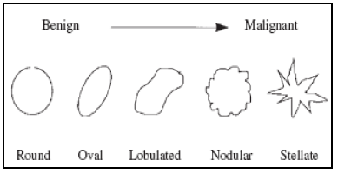
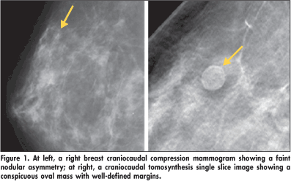
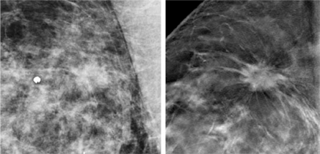
Problem Intro
Masses
Three-dimensional structure
Convex outward borders
Circumscribed → Spiculated

Slide 6
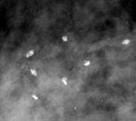
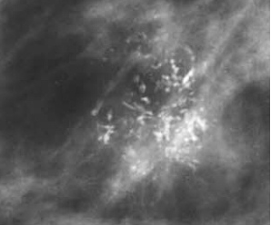
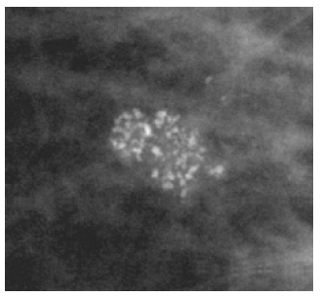
Problem Intro
Calcification
Course heterogeneous
Fine pleomorphic (< 0.5mm)
Benign: large, randomly spread
Malignant : clustered, irregular shape

Slide 7
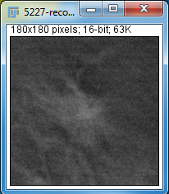
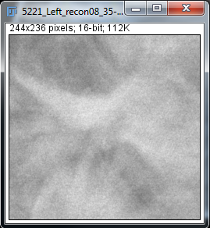
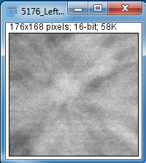
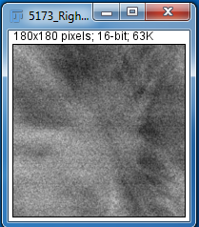




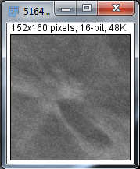
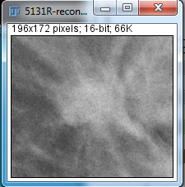
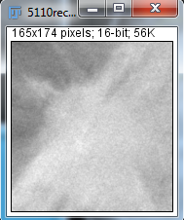
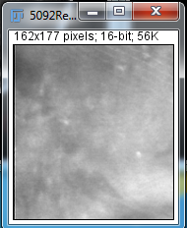





Slide 8
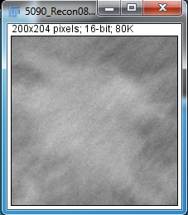
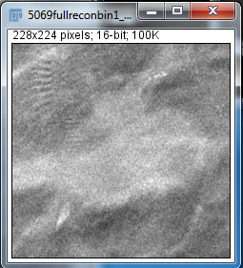
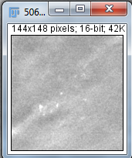
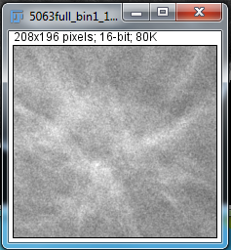




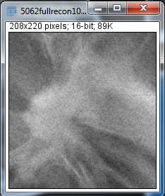
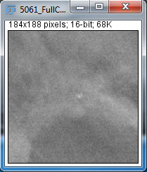
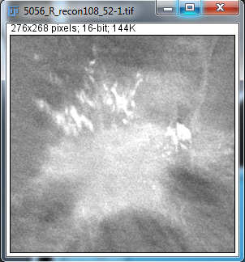
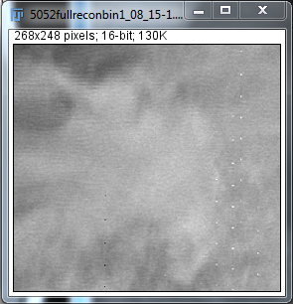





Slide 9
Outline
Data
Problem Intro
Workflow
Preprocessing
Mass Initial Detection
Mass Segmentation
Mass Classification
Calcification Detection

Slide 10
Workflow
Images
Preprocessing
Mass Extraction
Calcification
Segmentation
Graph cut(Level Set)
Mass detection
Wavelet/gabor
Calcification Detection
LOG
Feature Extraction
Reducing False positive by classification
Feature Extraction
Refine among neighboring slices
Classification

Slide 11
Outline
Data
Problem Intro
Workflow
Preprocessing
Mass Initial Detection
Mass Segmentation
Mass Classification
Calcification Detection

Slide 12
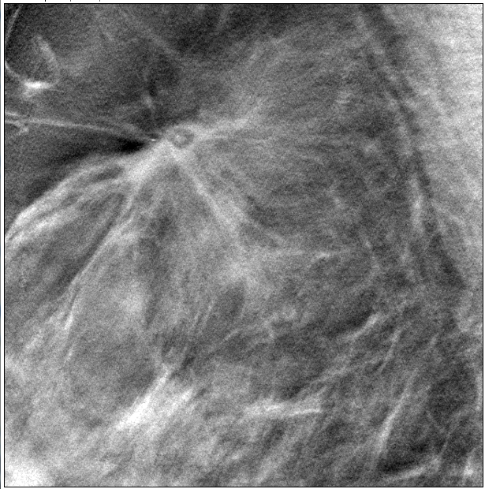
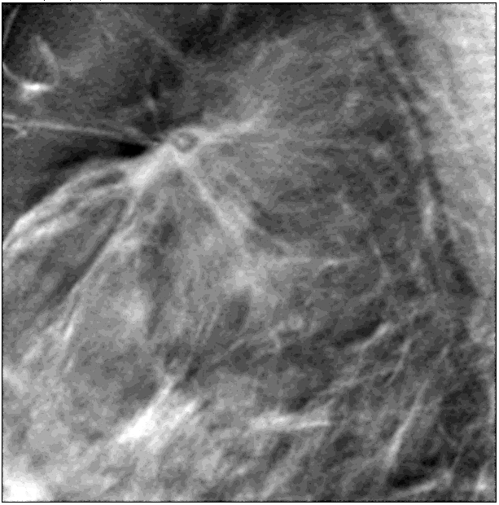
Preprocessing
Denoising
X-Ray Quantum noise: Poisson distribution, data dependent
Anscombe Transform
Adaptive Wiener Filtering
Inverse Anscombe Transform

Slide 13
Outline
Data
Problem Intro
Workflow
Preprocessing
Mass Initial Detection
Mass Segmentation
Mass Classification
Calcification Detection

Slide 14
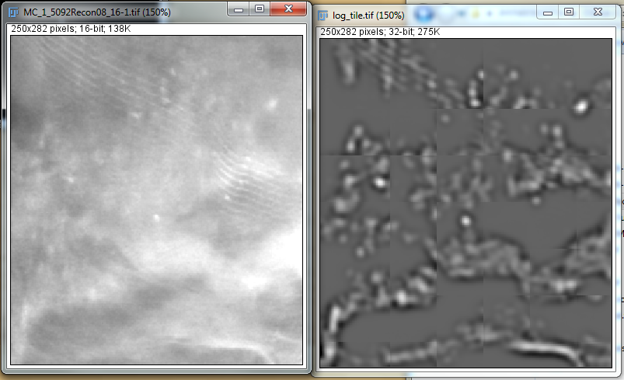
Calcification detection
Local foreground extraction
Calcifications are of high intensity(above 30%), set all other pixels to background
Avoid artificial boundary/gradient

Slide 15
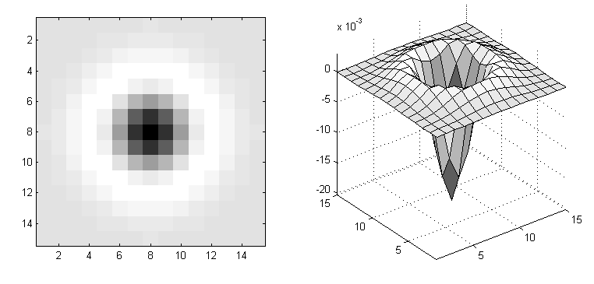
Calcification detection
Laplacian of Gaussian filtering

Slide 16
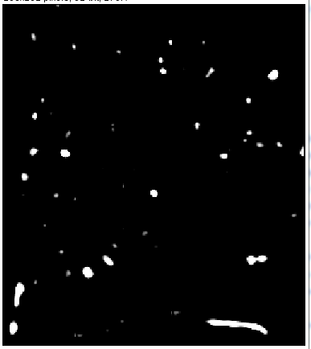
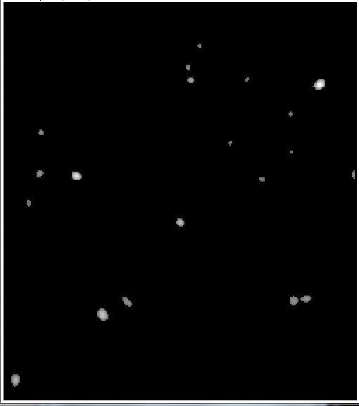
Calcification detection
Binaries response
Label connect component & Constraining
Notes:
Results could be slightly different applying different threshold and constrain;
Constrain: volume, adjacent co-occurence

Slide 17
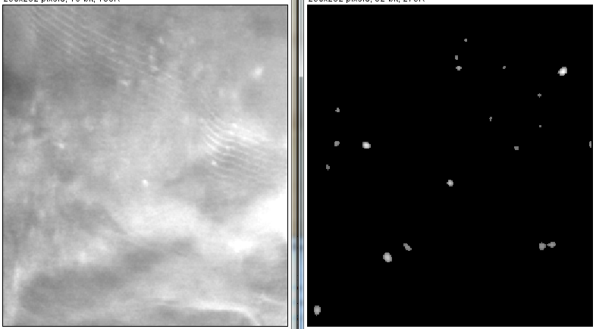
Calcification detection
Notes:
How to improve this?

Slide 18
Outline
Data
Problem Intro
Workflow
Preprocessing
Mass Initial Detection
Mass Segmentation
Mass Classification
Calcification Detection

Slide 19
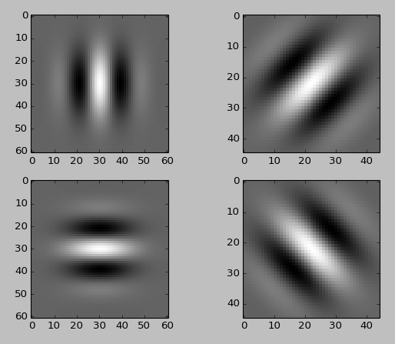
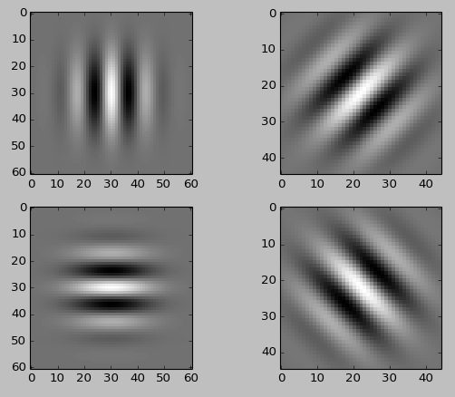
Mass Initial Detection
Gabor Filter Bank
(4, 15, 0.025,1)
(4, 15, 0.05,1)

Slide 20
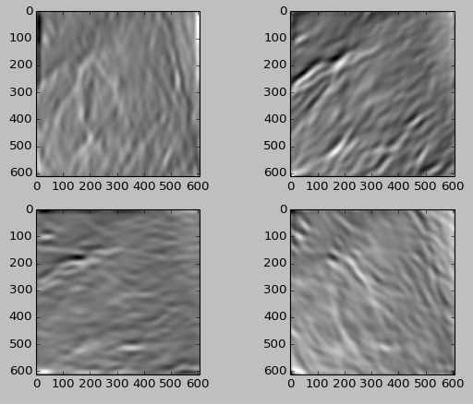
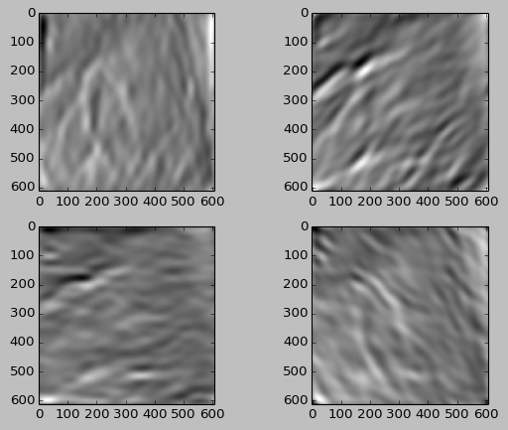
Mass Initial Detection
Gabor Wavelet Transform Response

Slide 21
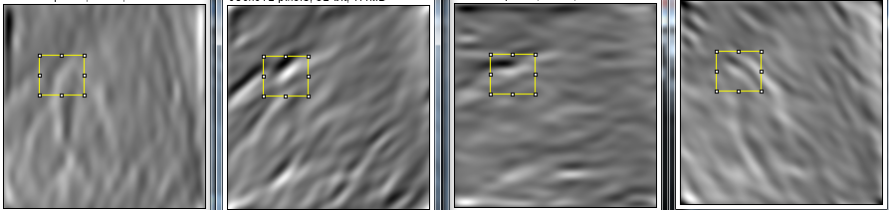

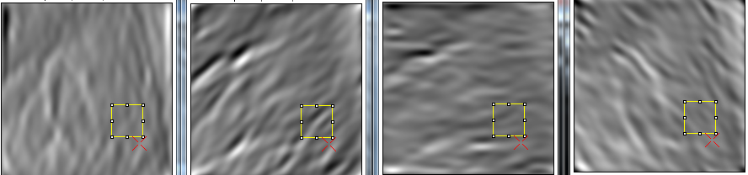
Mass Initial Detection
Response Voting
Orientation voting

Slide 22
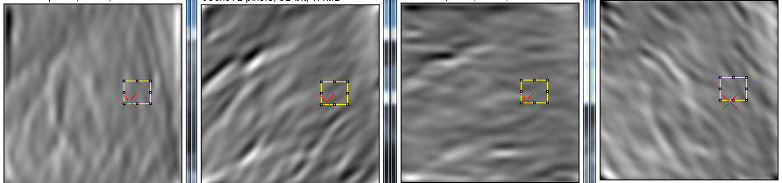




Mass Initial Detection
Response Voting
Intensity voting

Slide 23
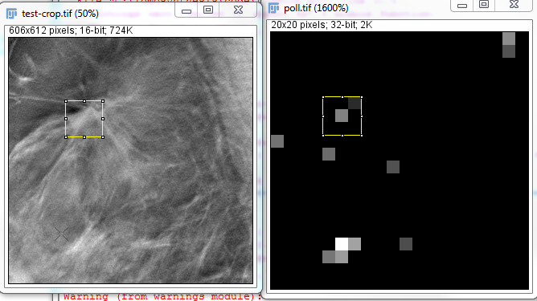
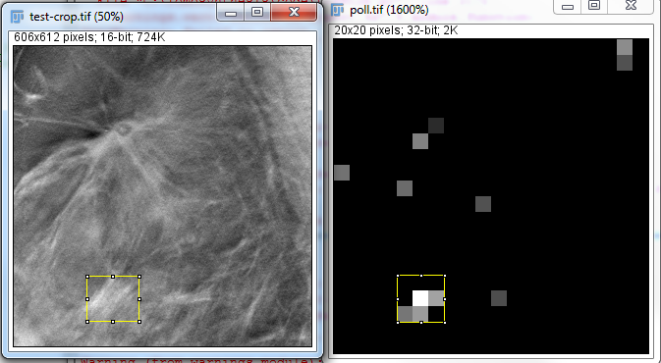
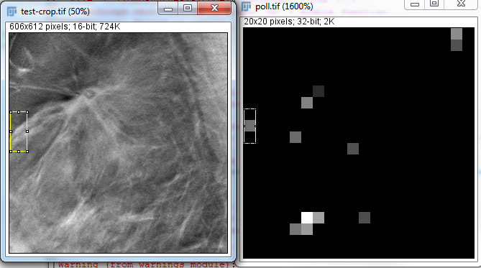
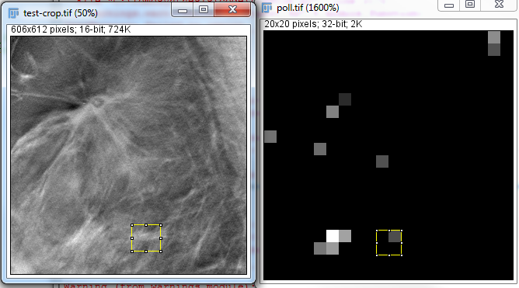
Mass Initial Detection

Slide 24
Outline
Data
Problem Intro
Workflow
Preprocessing
Mass Initial Detection
Mass Segmentation
Mass Classification
Calcification Detection

Slide 25
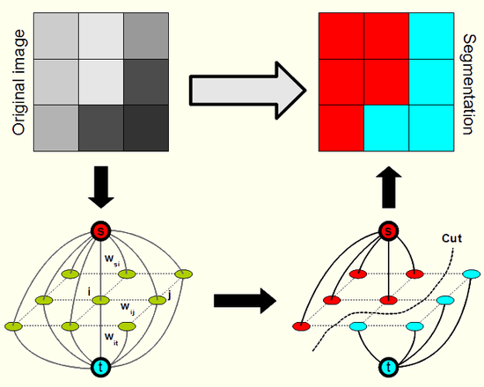
Mass segmentation
Graph cut

Slide 26
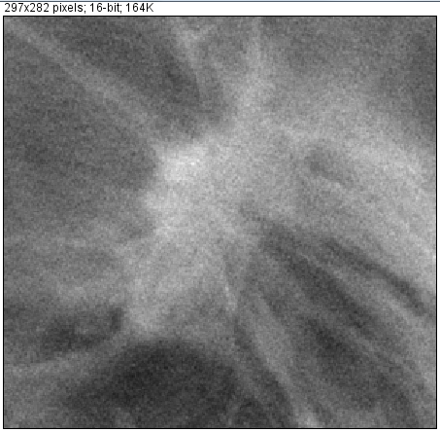
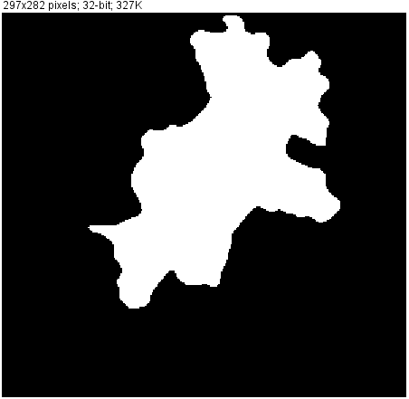
Mass segmentation
Level set

Slide 27
Outline
Data
Problem Intro
Workflow
Preprocessing
Mass Initial Detection
Mass Segmentation
Mass Classification
Calcification Detection

Slide 28
Mass Classification - Feature Extraction
Batch based features:
Segmentation based features:
Intensity
Gradient
Boundary distribution
Gradient

Slide 29
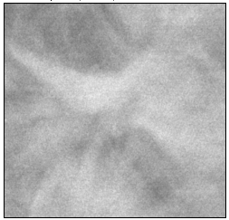
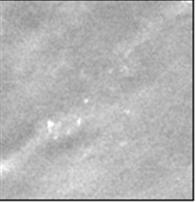
Feature extraction
Batch based Intensity statistic
Statistics of each ring:
Mean
Variance
Features extracted:
Mean linear slope
Variance linear slope

Slide 30
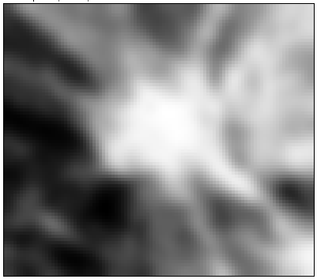
Feature extraction
Batch based Gradient Statistic
Perpendicular Index
0.6 | 0.8 | . | . | . | . | . | . | . | .

Slide 31
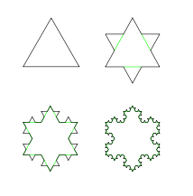
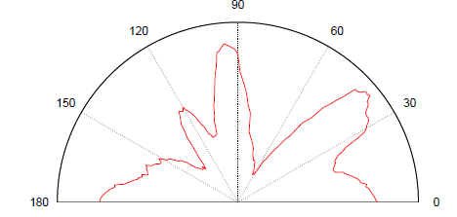
Feature extraction
Batch based Fractal dimension
Batch based Angular power spread
Notes:
From other papers

Slide 32
Feature Extraction
Segmentation based basic geometric features:
Segmentation based derived geometric features:
Area
CentralMoments
Eccentricity
Perimeter
Skewness
CentralSkewness
Compactness

Slide 33
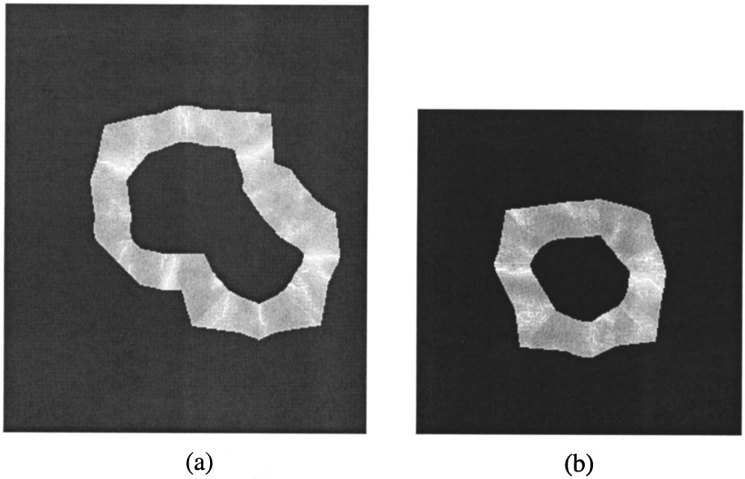

Feature Extraction
Segmentation based RBST features:

